Slide 1
COVID-19 Behavioral Changes
UMD DC21 - Team 5
Anna Nguyen, Linda Quach, Nancy Nguyen
Notes:
Dataset provided by UMD NCSG

Slide 2
Agenda
Define problem and purpose
Analysis (3)
Conclusion
Future Analysis
Recommendations

Slide 3
The Problem
Are the behavioral changes different per socio-demographic?
Does place of residence affect mode of commute before and after the pandemic?
Do the changes in physical activity have mental health implications?
Notes:
Linda

Slide 4
The Purpose
Illustrate changes using data visualizations
Notes:
Linda

Slide 5
Analysis
Assumptions
Physical vs. exercise activity
Physical activity before vs. after
Methods
Tableau
Notes:
Anna
Assumptions
Physical activity does not include exercise activity
Methods
Use Tableau to create data visualizations to better compare different variables

Slide 6
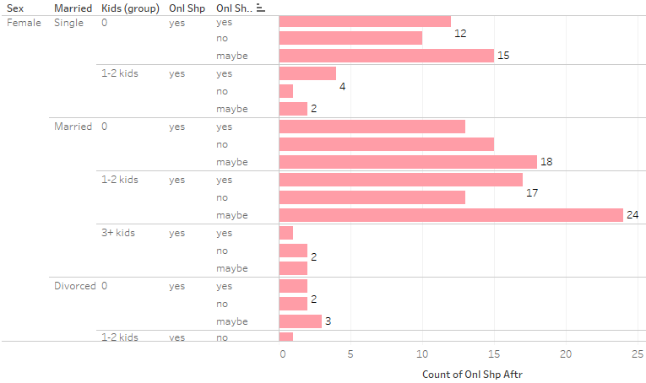
Female Preferences on Online Shopping
Notes:
Looking at these specific socio-demographic characteristics: gender, marriage status and how many kids they have.. This slide focuses on female preferences on continuing to shop online for groceries. Lookings at the trends, single or married, there isn’t a mutual consensus whether to continue online shopping or not. But it seems that single and married females with no children online shop more frequently than others. This might be because they find grocery shopping inconvenient and would rather spend their time on something else while females with children tend to not online shop as often because they see as an break from their routine.

Slide 7
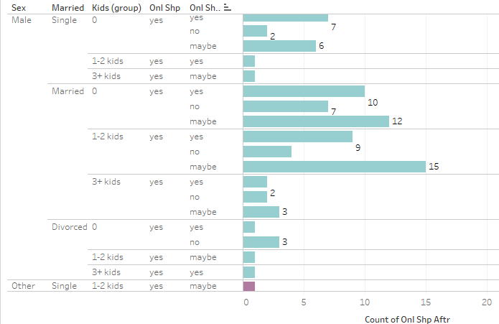
Male Preferences on Online Grocery Shopping
Notes:
Going on to the males preferences, it seems as though females are more prevalent to online shop rather than men which could indicate that males don’t see online grocery shopping as something that would change their behavior.

Slide 8
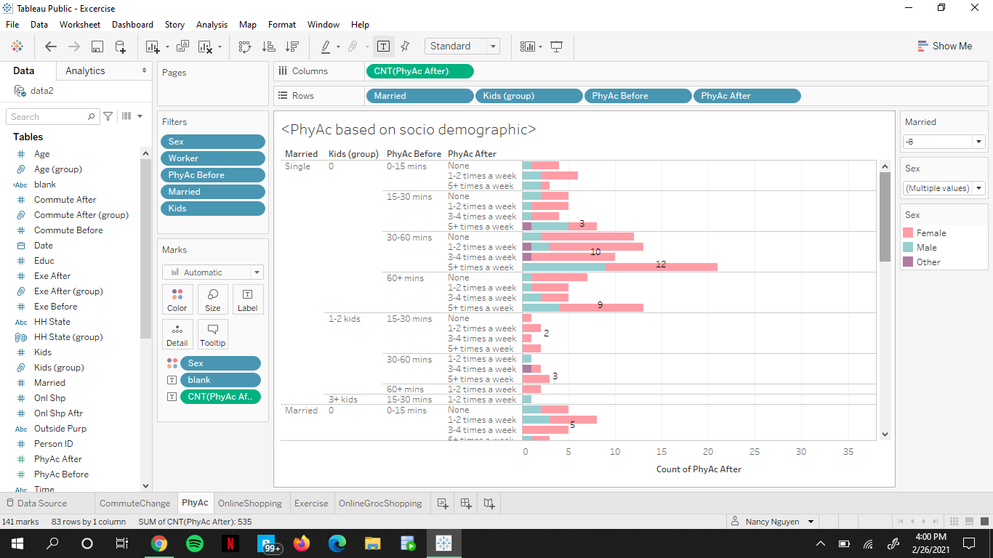
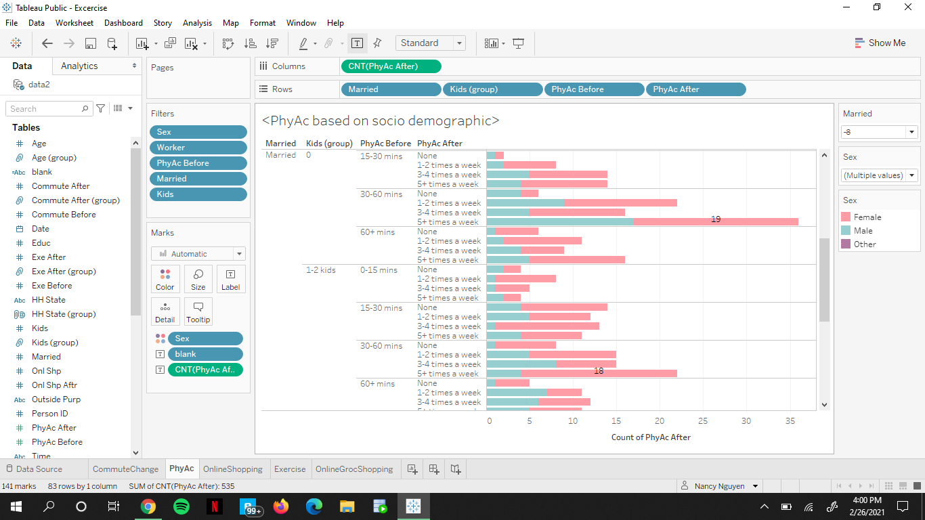
Gender Difference in Physical
Activity
Notes:
Moving on to physical activities, females tend to exercise more often than males during quarantine.But there is a noticeable increase in physical activity for those who have no children and this can contribute to using physical activity as a way to pass time and increase their mental health since they have more time on their hand.

Slide 9
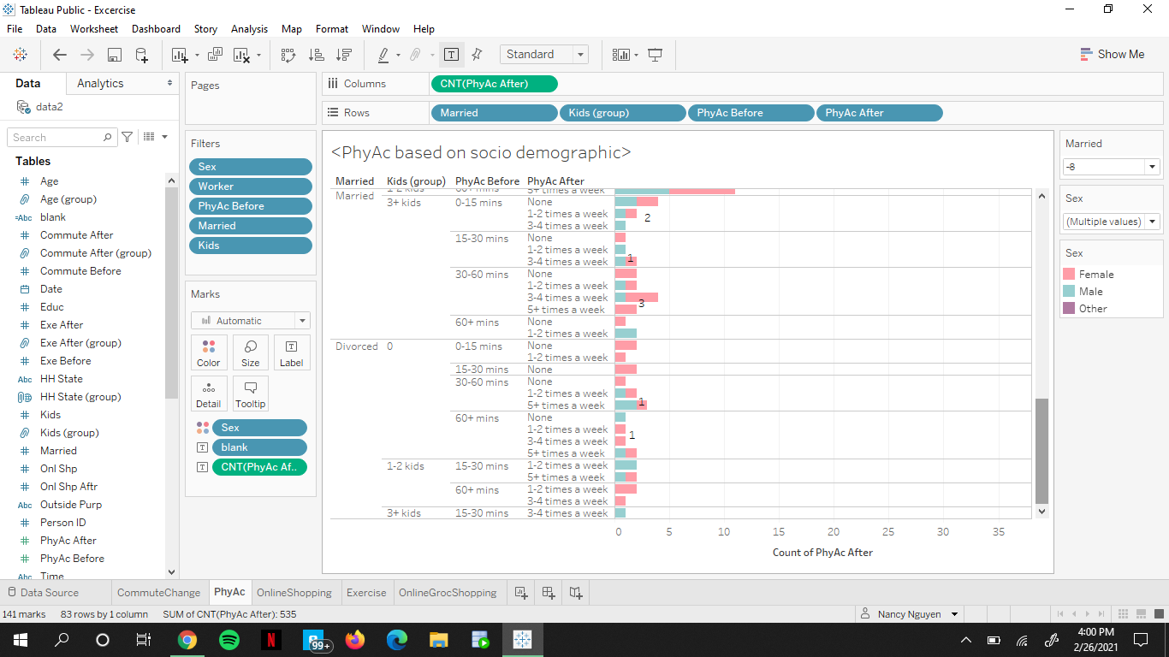
Gender Difference in Physical
Activity
Notes:
While for people that are married and have children, they seem to have less physical activities.This is because they have other responsibilities such as their children and want to focus on their child's wellbeing/education so they have less time on their hand and cannot find time to be active.

Slide 10
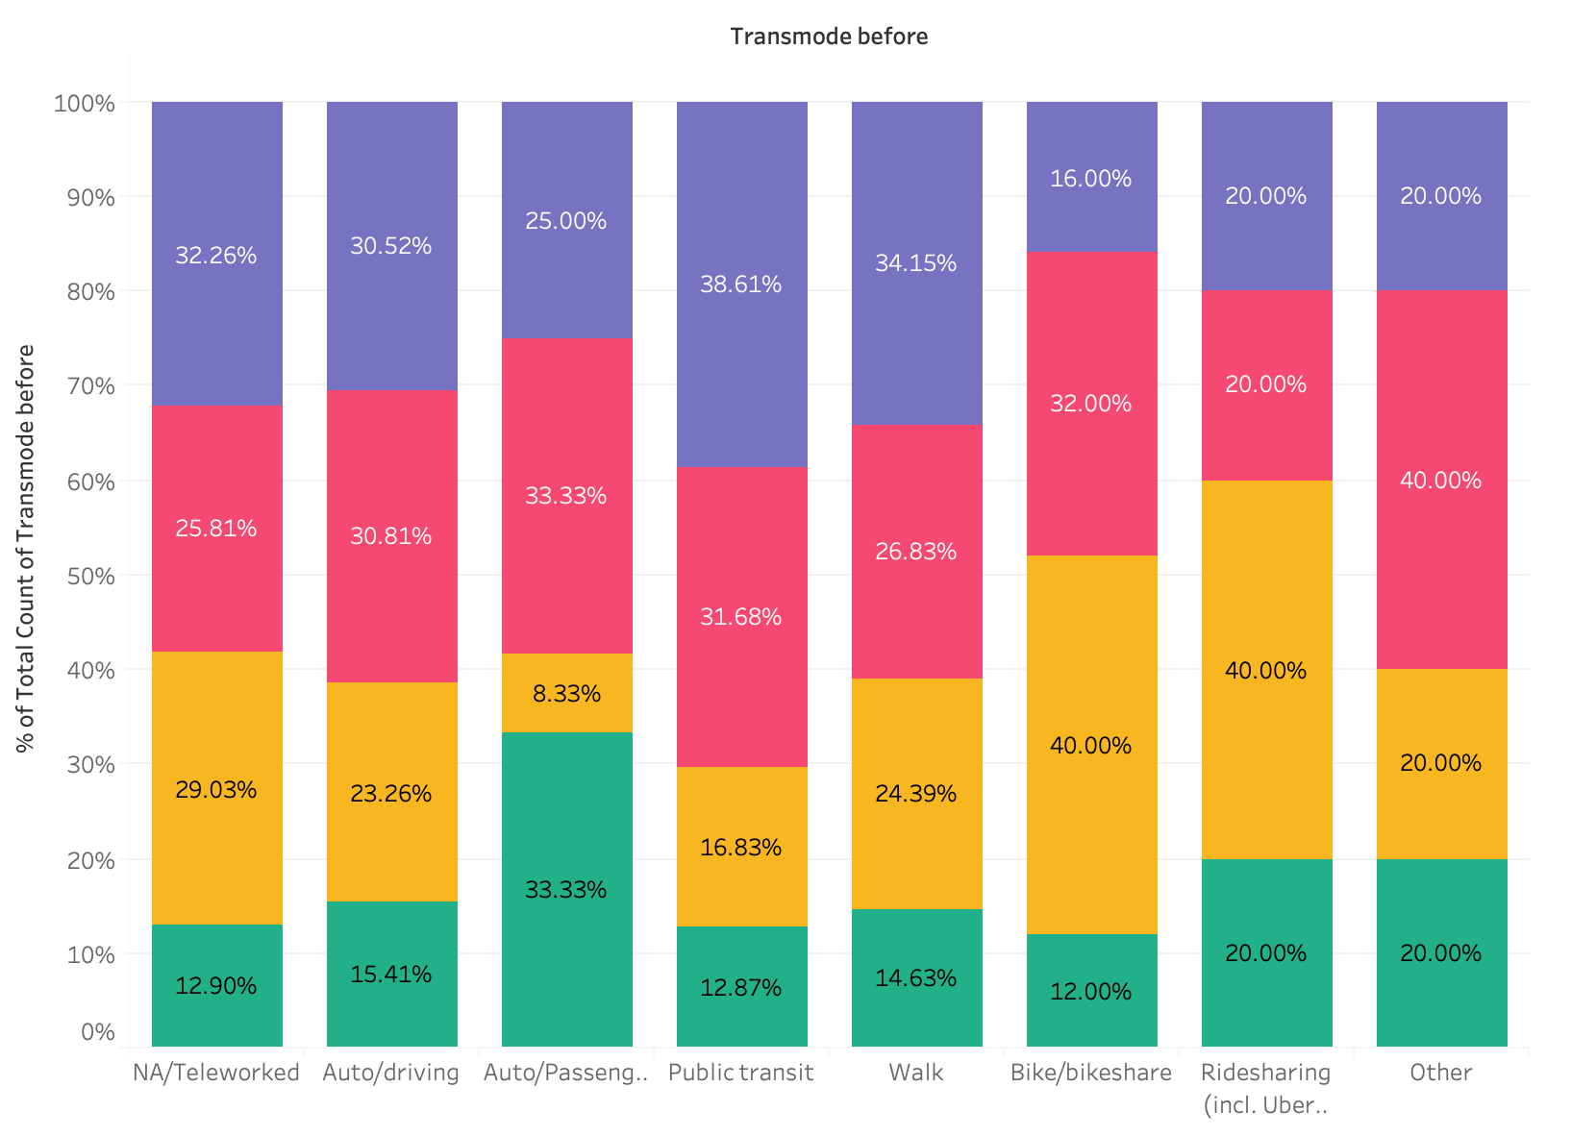
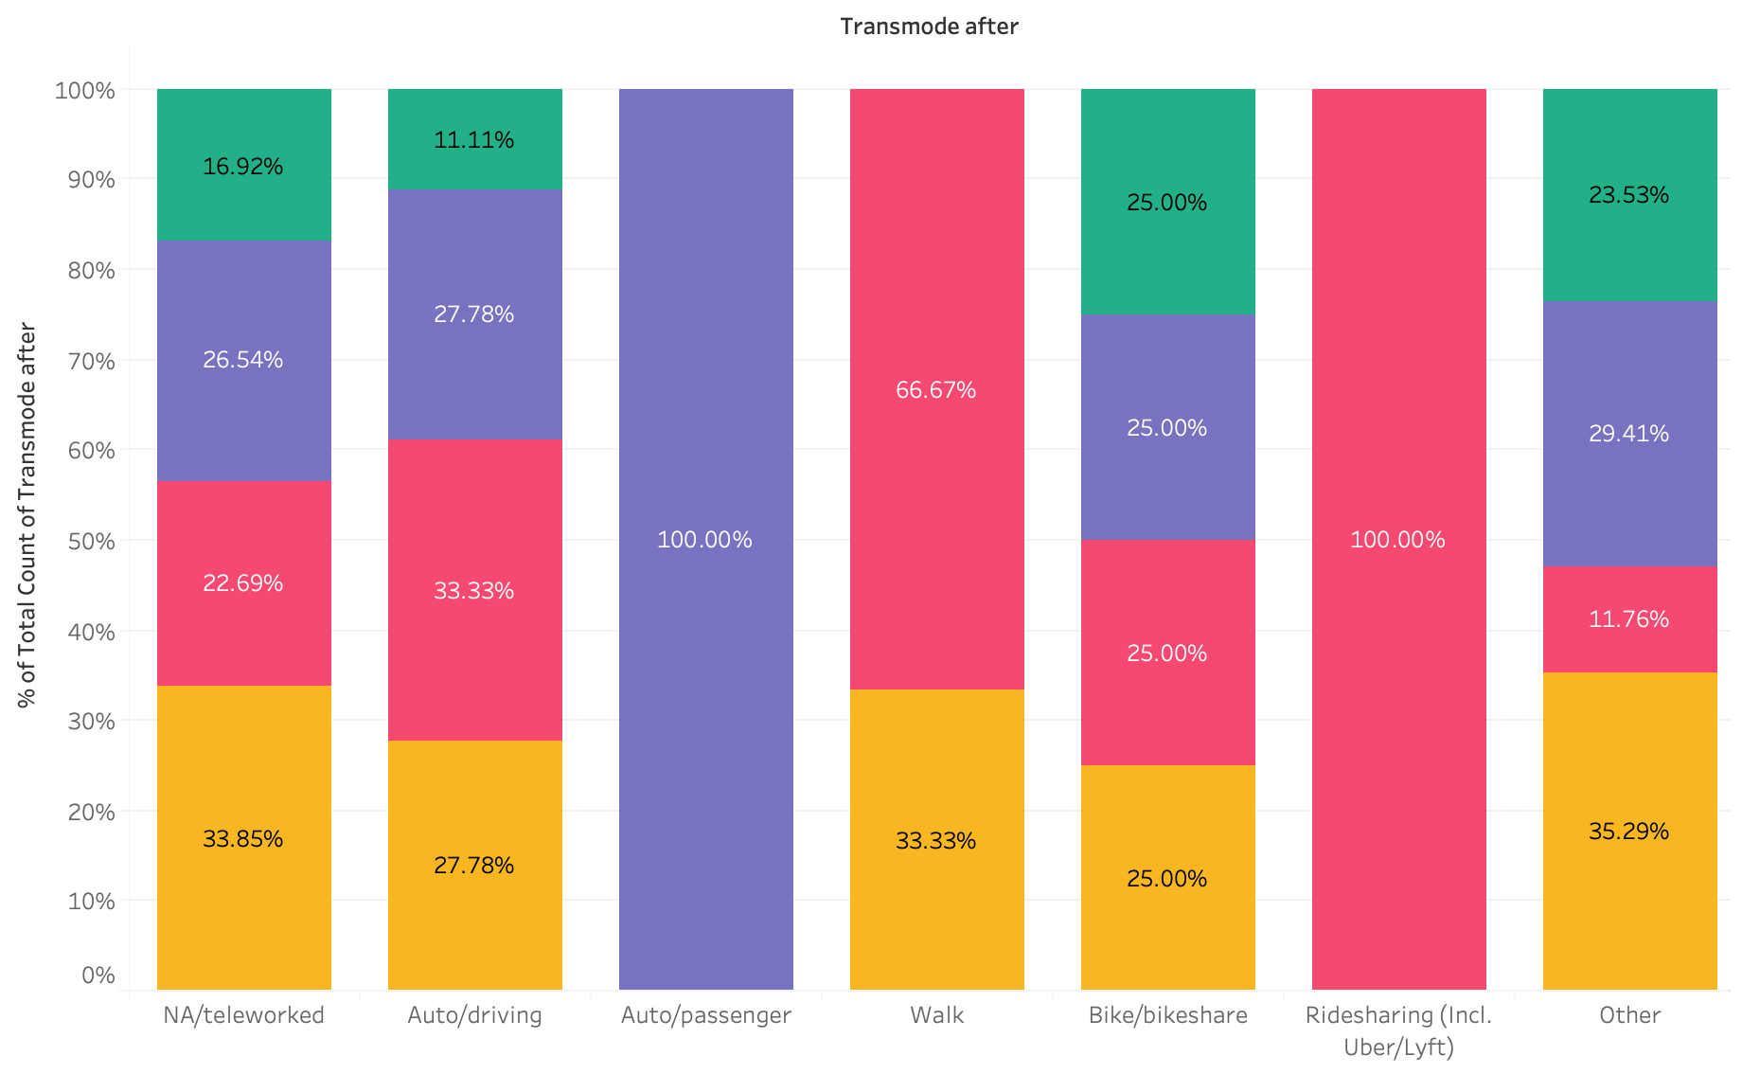
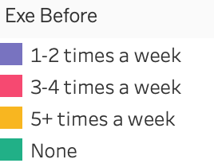
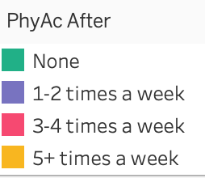
Transportation Mode vs Place of Residence

Slide 11
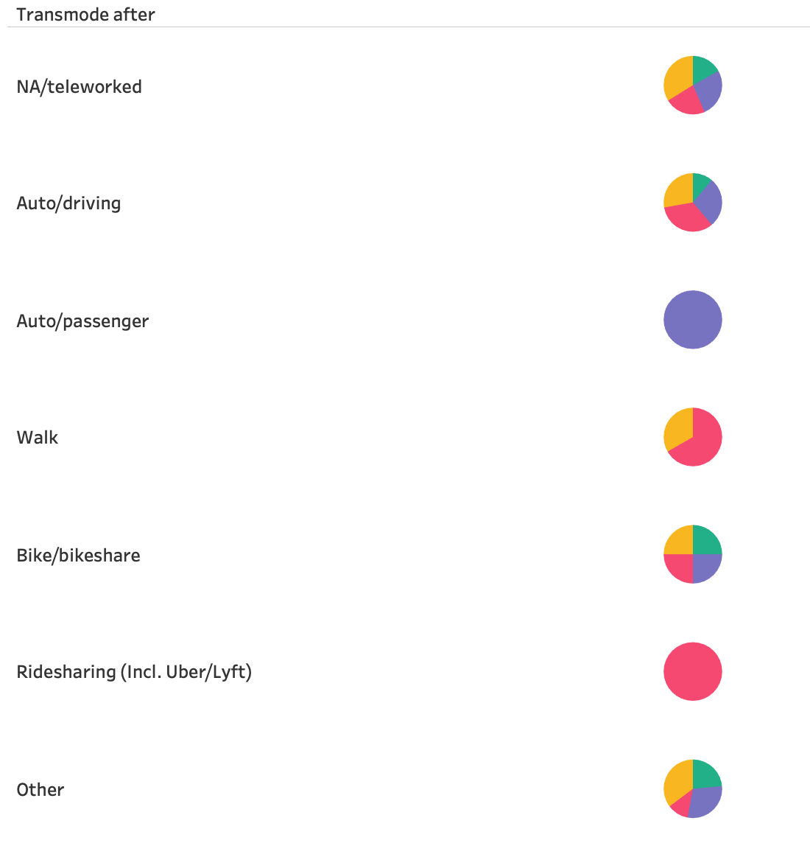
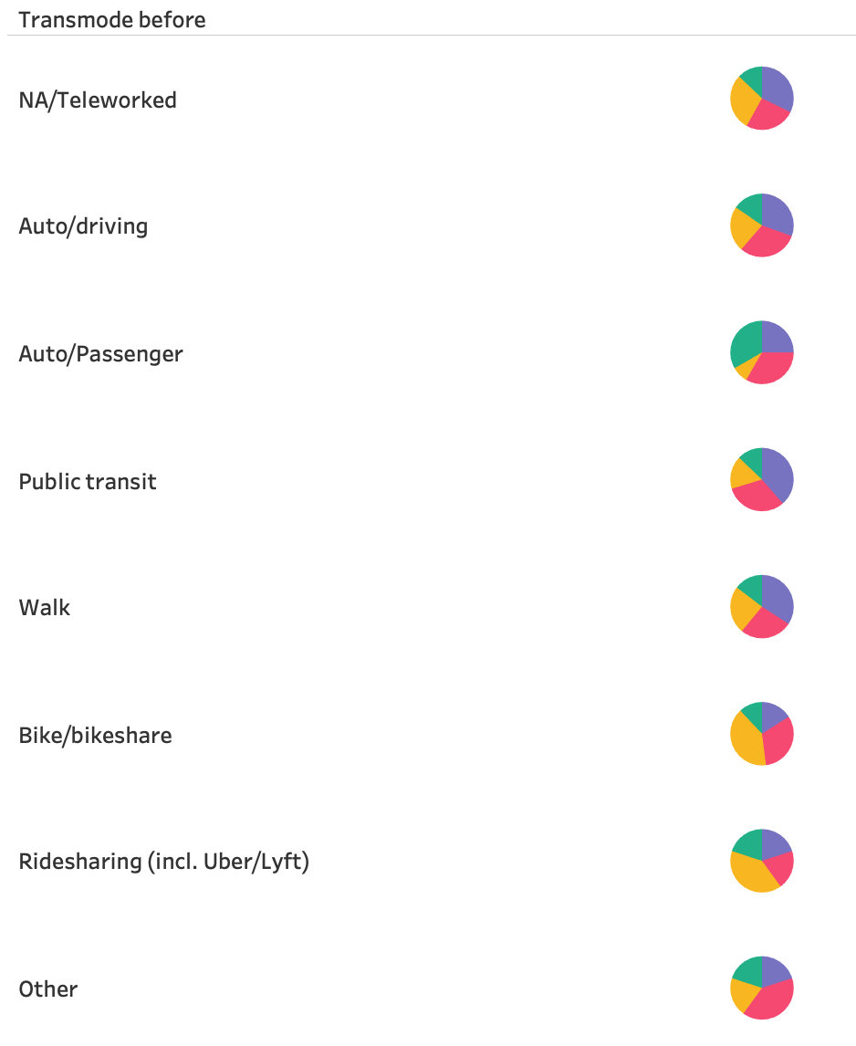
Transportation Mode vs Place of Residence
Notes:
Another way to show data

Slide 12
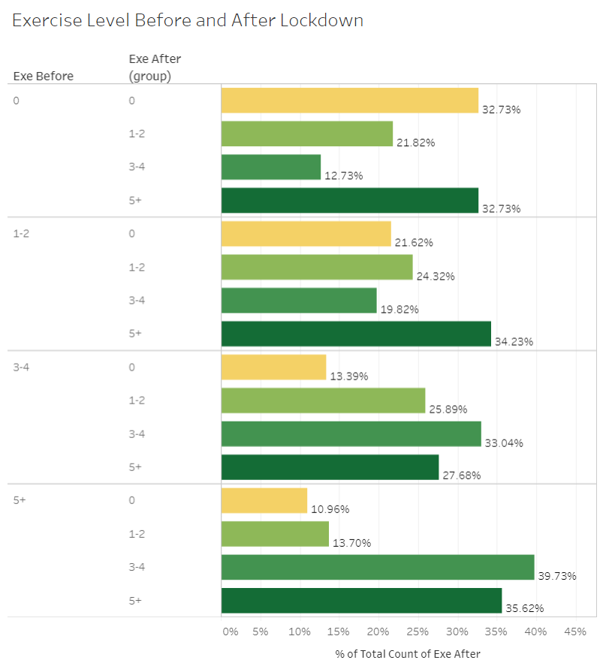
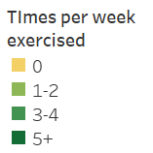
Changes in Exercise Level
Notes:
Focus on only on people who commuted everyday before lockdown

Slide 13
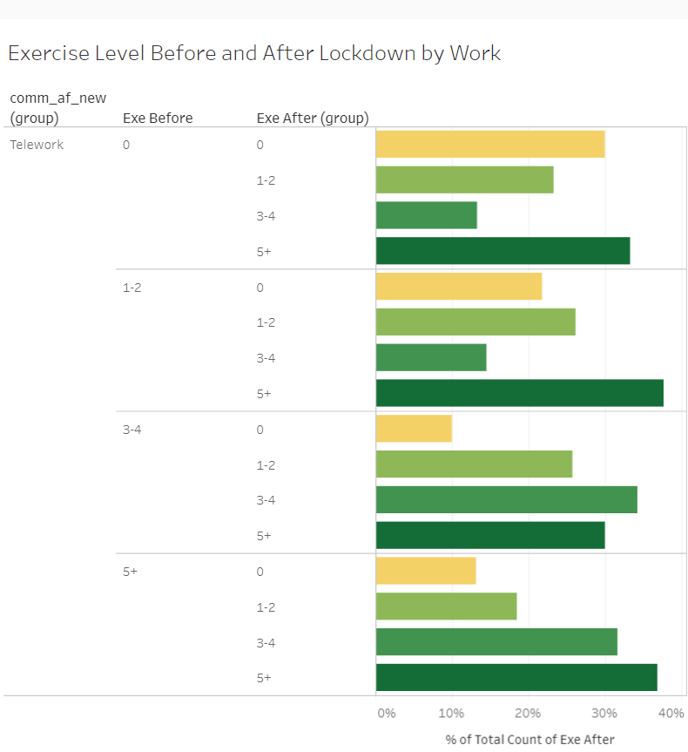
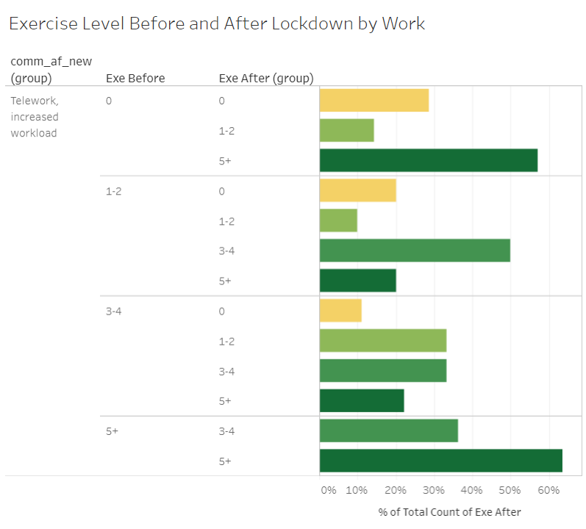

Slide 14
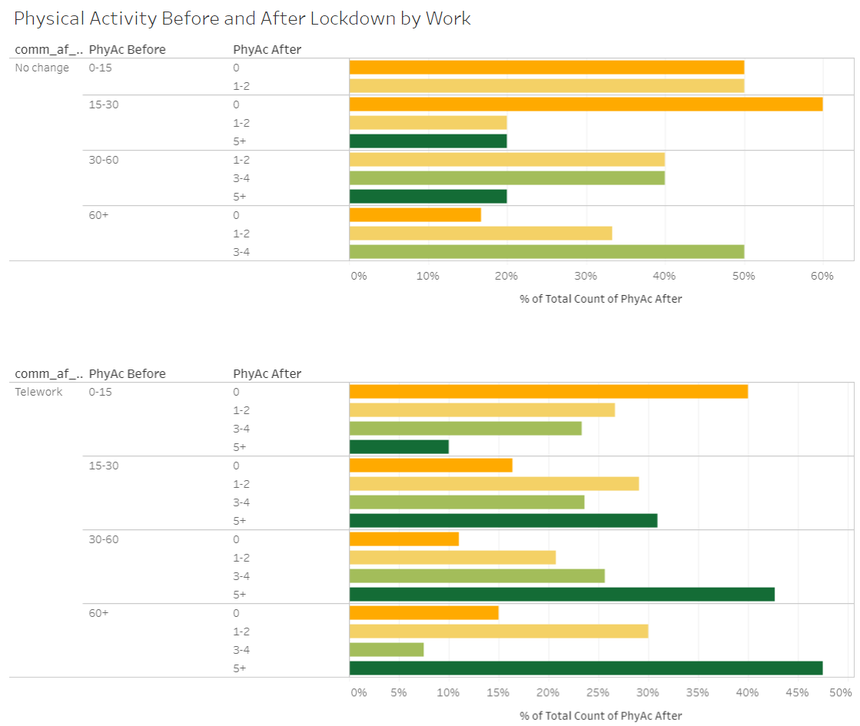
Changes in Physical Activity

Slide 15
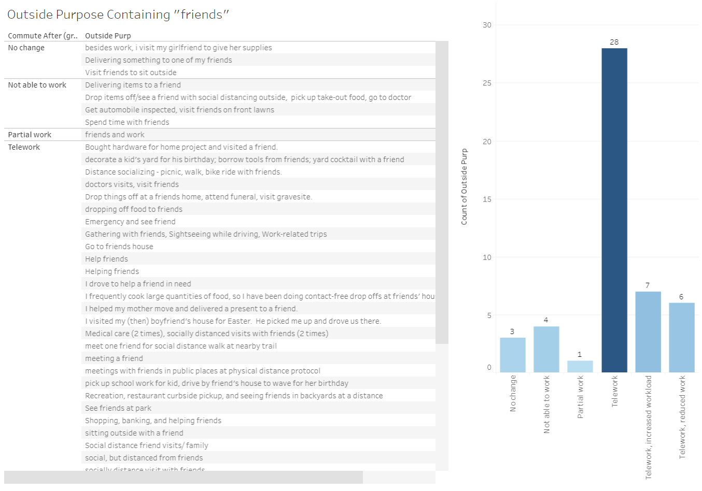
Other
Activities
Notes:
Noticed words like “crazy”, “safe”, “leisure car rides” and just “getting out of the house”

Slide 16
Conclusion
The pandemic has not only an economic impact, but a social impact, as well.
Stress levels will affect motivation, negatively or positively.
World Health Organization defines Quality of Life as: “an individual's perception of their position in life in the context of the culture and value systems in which they live and in relation to their goals, expectations, standards and concerns.”
Notes:
Anna
We see that the pandemic has not only had an economic impact, but a social impact as well. The pandemic has introduced new stressors into people’s lives causing them to take action to alleviate it which can be seen in their change in behavior.
We looked at their transportation mode before lockdown and compared it to their physical activity after and saw that during lockdown they become more active to probably mimic their old routine.
Changes in grocery shopping level in households with kids, we saw that married females were more reluctant to try online grocery shopping, probably because physical grocery shopping was a way for them to get out of the house
Furthermore, we saw that for those who had a change in the way they worked (from in person to telework) they also were more active, even in those who had increased works
WHO Quality of Life definition. The pandemic has changed life for our lot of us and we’ve all had to find ways to adapt. The changes in behavior indicate how we are trying to make the best of the current situation in order to improve our own quality of life.

Slide 17
Future Analysis
Look at population by zip code, as well
Use text mining to better sort outside activities after lockdown
Create accuracy models to assess our inferences
Tableau Public Links:
https://public.tableau.com/profile/anna.nguyen6309#!/
https://public.tableau.com/profile/nancy.nguyen1581#!/
https://public.tableau.com/profile/linda.quach#!/
Notes:
Linda
Use text mining to better categorize the different reasons people went out and see the proportion of it

Slide 18
Recommendations
Social activities using virtual platforms
Daily physical activity or mental breaks
Mimic pre-COVID routines
Notes:
Nancy
To better help those who have noticed any negative changes due to quarantine, it is recommended that people should go out on walks when the sun is out to feel better or taking mental health days to focus on their needs. And for those who feel disconnected from humanity, they should try to mimic pre-Covid routines by reach out on social platforms where video calling is an option and play games that involve groups to increase social interaction. Thank you for listening to our presentation, do you have any questions you would like to ask us?

